Slide 1
Service-Level Agreements (SLAs)
in Cloud Computing
Ensuring Accountability and Performance

Slide 2
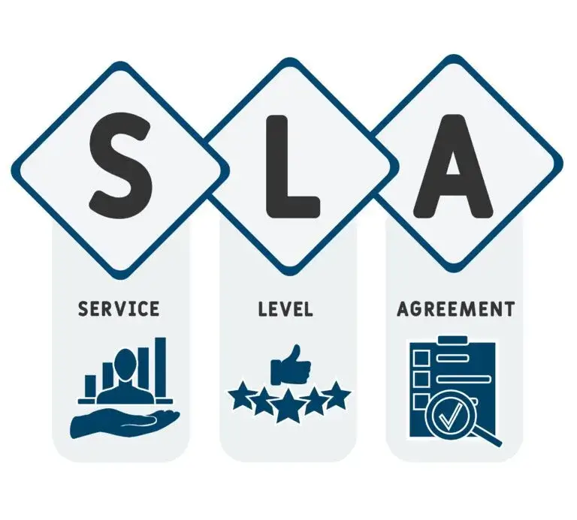
What is an SLA?
Formal agreement between a cloud service provider (CSP) and a customer.
Defines measurable metrics like uptime, response time, and support.
Legally binding document to ensure accountability.

Slide 3
Key Components of an SLA
Service Scope: What services are covered?
Performance Metrics: Uptime (e.g., 99.9%), latency, etc.
Responsibilities: Roles of CSP vs. customer.
Penalties: Credits/refunds for unmet metrics.
Exclusions: Situations where SLA doesn’t apply (e.g., outages due to customer error).

Slide 4
Types of Cloud SLAs
Standard SLA: Predefined terms for all customers (e.g., public cloud providers).
Custom SLA: Tailored for enterprise clients with specific needs.
Multi-tier SLA: Different levels for different services (e.g., storage vs. compute).

Slide 5
Importance of SLAs in Cloud Computing
Ensures transparency between CSP and customer.
Minimizes downtime risks with uptime guarantees.
Provides legal recourse for breaches.
Builds trust in cloud adoption.

Slide 6
Common SLA Metrics
Uptime: e.g., 99.9% ("three nines") = ~8.76 hours downtime/year.
Response Time: Time to address support tickets.
Data Availability: Redundancy and backup guarantees.
Security: Compliance certifications (e.g., ISO 27001).

Slide 7
Calculate the allowable downtime
Determine Total Time in Desired Period For a year: 365 days/year×24 hours/day=8760 hours/year.
Convert Uptime Percentage to Downtime Fraction Example for 99.9% uptime:
1−0.999=0.001 (or 0.1%).
Calculate Downtime Duration Multiply downtime fraction by total time:
0.001×8760 hours=8.76 hours/year.

Slide 8
General Formula:
Downtime=(1−Uptime Percentage)×Total Time in Period
Examples for Common Uptime SLAs:
Uptime (%) Downtime per Year Downtime per Month (30 days)
99.9% ~8.76 hours ~43.8 minutes
99.99% ~52.56 minutes ~4.38 minutes
99.999% ~5.26 minutes ~26.3 seconds

Slide 9
Challenges with SLAs
Complexity: Hard to measure metrics like performance.
Vagueness: Ambiguous terms (e.g., "best effort").
Multi-tenancy: Shared resources may impact performance.
Enforcement: Difficulty claiming penalties.

Slide 10
Best Practices for SLAs
Negotiate clear, measurable metrics.
Understand exclusions (e.g., maintenance windows).
Monitor compliance with third-party tools.
Review and update SLAs as needs evolve.

Slide 11
Real-World Example
AWS EC2 SLA: 99.99% uptime for Enterprise Support.
Azure: Credits for downtime exceeding SLA thresholds.
Google Cloud: Tiered SLAs for different services.

Slide 12
Sample Question
Kloud 360, a company uses a cloud provider with a 99.95% uptime SLA. Last year, the service was down for 4 hours due to a server failure and 1 hour during scheduled maintenance.
What is SLA? Difference between a standard SLA and a custom SLA?
Did the provider breach the SLA?
What recourse does Company Kloud 360 have if the SLA was breached?

Slide 13
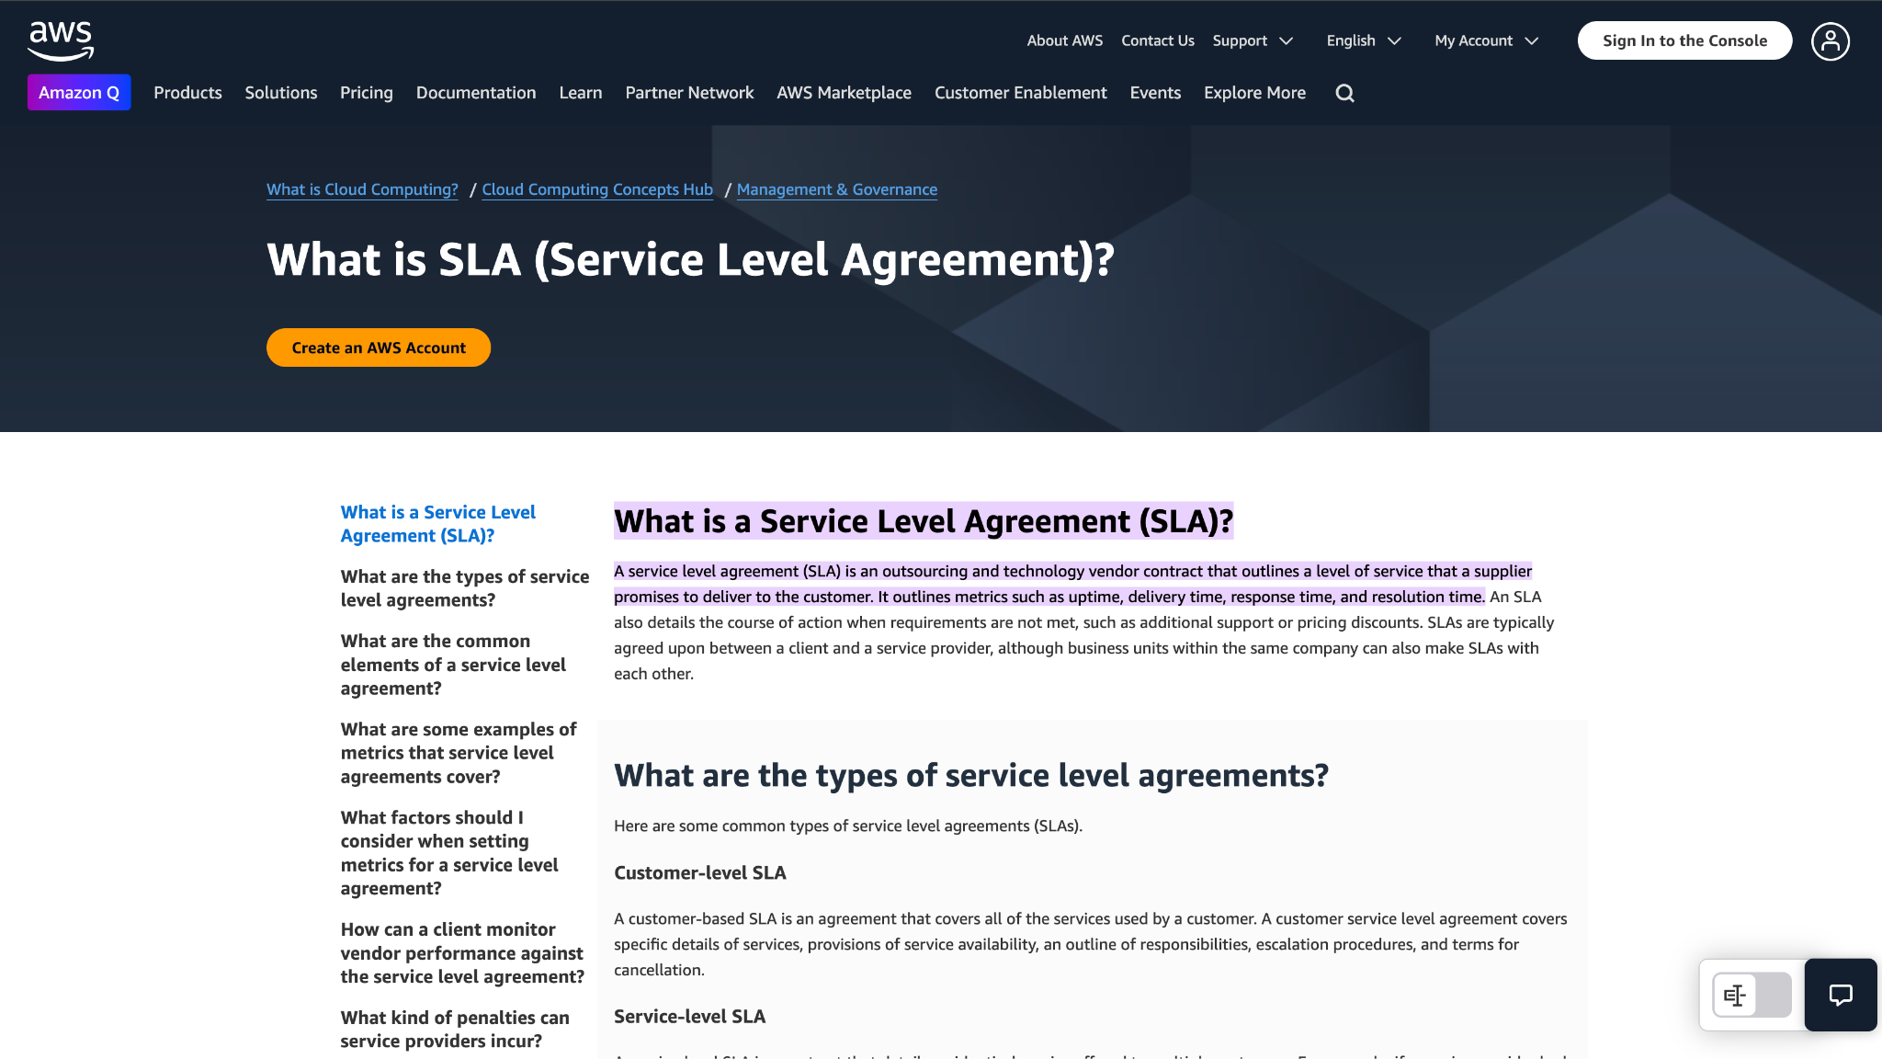

Slide 14
Summary
SLAs are critical for defining expectations in cloud services.
Focus on metrics, penalties, and clarity.
Always review and monitor SLAs actively.

